Slide 1
Human Centered Computing
Nisheeth
ESB2/602

Slide 2
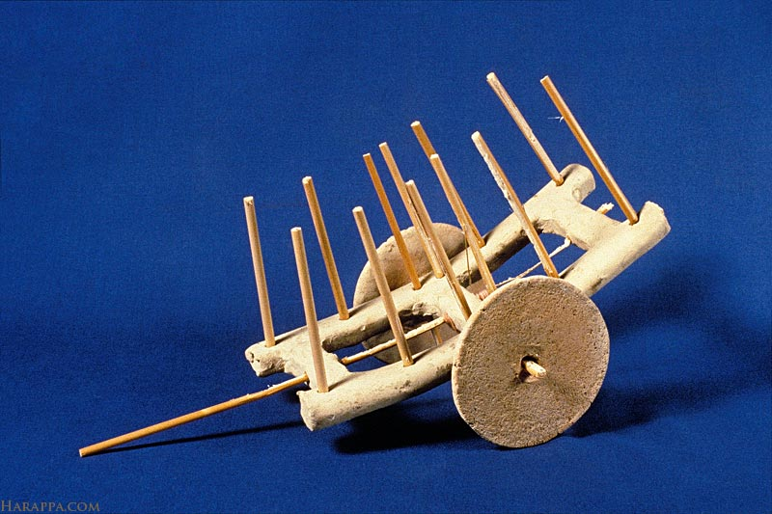
Anthropology exercise

Slide 3
Possible inferences
They were bipedal
They had division of labor, but were primarily agrarian
They lived on flat terrain
Typical travel distances shorter than 20 kms
They had a civic governance system

Slide 4

Anthropology exercise

Slide 5
Possible inferences
A whole lot of people
Mechanized industrial production
Massive communication infrastructure
Lots of loneliness, not much to do

Slide 6

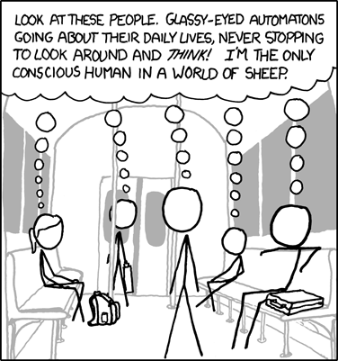
Personal data is way more interesting

Slide 7
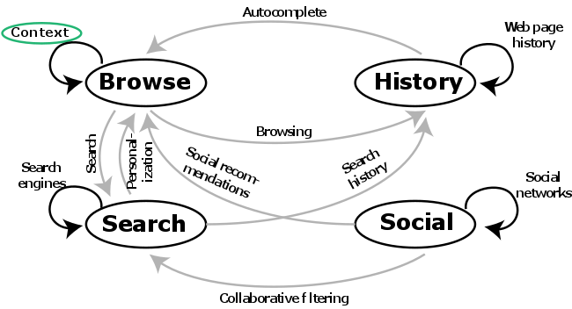
Human-centered computing

Slide 8
Course structure
Search (Topic modelling)
Architecture
Text processing
Query processing
Retrieval models
Evaluation
Recommender systems (Movielens)
Types of recommender systems
Optimization
Evaluation
Context sensitivity

Slide 9
Course structure
Affective computing (Sentiment Analysis)
Sentiment analysis
Theory
Applications
Emotion inference
Theory
Applications
IT and Society (Essay)
Centralization and legitimacy
Automation and the power principle
Existentialism and cyberpunk
The classical virtues

Slide 10
Course evaluation
5 projects
Preferable to work in teams (2-3)
Within project evaluation
40% code
30% report
30% presentation (5+2 mins) – peer-scored
I’ll be looking for both competence and creativity
Projects will use (avg+max)/2 scoring
No relative grading
Cooperation bonus in projects (+5 to both counterparties)
Projects will be assigned at the beginning of each course module

Slide 11
Expectations
Learn to do practically
Understand theoretically
Think about how to apply in ways that help other people

Slide 12
Course logistics
Lecture slides will be posted online at the time of the lecture
No attendance restrictions, but you will suffer if you are irregular
0.9x daily multiplicative penalty for late submissions

Slide 13
Course logistics
Lecture slides and code samples will be posted to helloIITK
We’ll use helloIITK to manage all course submissions too

